Slide 1

WHY ARE WE HERE?
Notes:
Our 2020 climate goal is to reduce our carbon impact OF THE DRINK IN YOUR HAND by 25%, a goal which is an essential part of our Me, We, the World environmental commitment.

Slide 2
GOAL REDUCE CARBON,
25%
DRINK IN YOUR HAND
Notes:
Our 2020 climate goal is to reduce our carbon impact OF THE DRINK IN YOUR HAND by 25%, a goal which is an essential part of our Me, We, the World environmental commitment.

Slide 3

WWF CLEAN ECONOMY: Financial Times Ad Dec/18 (final official day of COP15)
CHANGING
HOW WE
DO BUSINESS

Slide 4
AMBASSADORS ARE
LEADERS
EXPERTS
INNOVATORS
CHANGE MAKERS
VALUE CREATORS
Notes:
To be able to work along our supply chain, we will need to learn how to operate outside of our sphere of control, working alongside our suppliers, distributors, and partners to jointly tackle the challenges and opportunities of reducing climate impact. This is a big challenge; and we’ll need a strong group of leaders to champion this change in our system. It is a big change too – we are very accustomed to being able to control our projects. That’s much harder when working with external parties. That is where the Climate Ambassadors will play a role – we are educators, trainers, motivators, and eventually experts.
WHO ARE THE AMBASSADORS? Climate Ambassadors are select Coca-Cola System employees who can strategically inform and catalyze their colleagues and suppliers to engage in carbon reduction actions that help our System achieve our 2020 Climate Target and create value for our organization.
Climate Ambassadors are strong voices in the System who want to be leaders in transforming the business to meet changing market demand and environmental opportunities—for the bottom line and to meet our mission. Climate Ambassadors also support the process for establishing local goals.
There are two levels of Ambassadors: Climate Ambassadors and Expert Ambassadors.
Climate Ambassadors are strategists, champions, and communicators from across the System who are trained to carry messages about Coca-Cola’s 2020 climate goals to internal colleagues, Bottlers, and suppliers to promote engagement in climate action across the value chain. These Ambassadors also work to at the local level, help set local 2020 climate goals.
Expert Ambassadors cover the functions of Climate Ambassadors, but are additionally equipped to work directly with Bottlers and suppliers to drive implementation of significant carbon reduction activities Expert Ambassadors generally have technical backgrounds.
ROLE OF THE CLIMATE AMBASSADOR Climate Ambassadors spark conversations with employees, bottling partners, and suppliers about the importance and business benefits of innovating climate practice along the supply chain. Ambassadors carry the message about 4 main concepts:
Coca-Cola’s 2020 Climate Commitment
The Business Case for Acting on Climate along the Supply Chain
Opportunities (and Business Benefits) along Supply Chain – that can be Tapped through Partnerships with Suppliers
How to Get Started: Models for Partnering on Supply Chain Climate Action
How to Set Goals Locally using Carbon Achievements Planner
into key internal areas like sales, procurement, supply chain, and strategy functions; and directly to key suppliers.
Climate Ambassadors train their colleagues to think beyond their “sphere of control” to their “spheres of influence”. They catalyze Coca-Cola employees, bottling partners, and suppliers to take up joint climate action along the supply chain. Ambassadors build attention to and excitement for climate innovation.

Slide 5
LEADERS IN OUR SYSTEM
ROLE OF THE CLIMATE AMBASSADOR
“strategically inform and catalyze our colleagues and suppliers to engage in carbon reduction actions that help our System achieve our 2020 Climate Target and create value for our organization.”
Notes:
To be able to work along our supply chain, we will need to learn how to operate outside of our sphere of control, working alongside our suppliers, distributors, and partners to jointly tackle the challenges and opportunities of reducing climate impact. This is a big challenge; and we’ll need a strong group of leaders to champion this change in our system. It is a big change too – we are very accustomed to being able to control our projects. That’s much harder when working with external parties. That is where the Climate Ambassadors will play a role – we are educators, trainers, motivators, and eventually experts.
WHO ARE THE AMBASSADORS? Climate Ambassadors are select Coca-Cola System employees who can strategically inform and catalyze their colleagues and suppliers to engage in carbon reduction actions that help our System achieve our 2020 Climate Target and create value for our organization.
Climate Ambassadors are strong voices in the System who want to be leaders in transforming the business to meet changing market demand and environmental opportunities—for the bottom line and to meet our mission. Climate Ambassadors also support the process for establishing local goals.
There are two levels of Ambassadors: Climate Ambassadors and Expert Ambassadors.
Climate Ambassadors are strategists, champions, and communicators from across the System who are trained to carry messages about Coca-Cola’s 2020 climate goals to internal colleagues, Bottlers, and suppliers to promote engagement in climate action across the value chain. These Ambassadors also work to at the local level, help set local 2020 climate goals.
Expert Ambassadors cover the functions of Climate Ambassadors, but are additionally equipped to work directly with Bottlers and suppliers to drive implementation of significant carbon reduction activities Expert Ambassadors generally have technical backgrounds.
ROLE OF THE CLIMATE AMBASSADOR Climate Ambassadors spark conversations with employees, bottling partners, and suppliers about the importance and business benefits of innovating climate practice along the supply chain. Ambassadors carry the message about 4 main concepts:
Coca-Cola’s 2020 Climate Commitment
The Business Case for Acting on Climate along the Supply Chain
Opportunities (and Business Benefits) along Supply Chain – that can be Tapped through Partnerships with Suppliers
How to Get Started: Models for Partnering on Supply Chain Climate Action
How to Set Goals Locally using Carbon Achievements Planner
into key internal areas like sales, procurement, supply chain, and strategy functions; and directly to key suppliers.
Climate Ambassadors train their colleagues to think beyond their “sphere of control” to their “spheres of influence”. They catalyze Coca-Cola employees, bottling partners, and suppliers to take up joint climate action along the supply chain. Ambassadors build attention to and excitement for climate innovation.

Slide 6
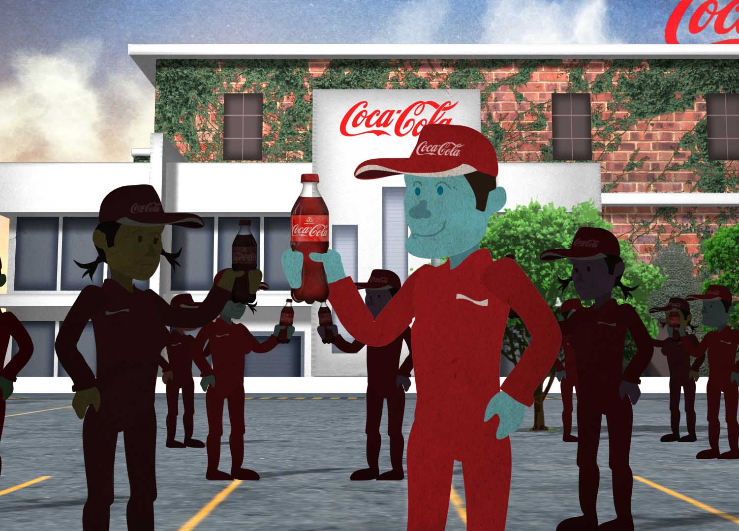
THE BENEFITS
FOR OUR AMBASSADOR TEAM
GOAL
SETTING
RECOGNITION BY
KO + WWF
EXECUTIVE TRAINING
HIGH LEVEL NETWORKING
OPPORTUNITIES
Notes:
Although Ambassadors are individuals who want to participate in this high-visibility role in the company and who want to lead conversations in their own organizations, KO commits to providing:
Opportunities to participate in goal-setting
Executive, leadership, and technical trainings to build skill-sets and capabilities of the participants
Recognition by KO and our partner WWF
Contact with high-level environmental and business thought leaders
Opportunities to participate in local components of global environmental initiatives
You’ll network with colleagues and become a community and be supported throughouth.

Slide 7


TRAINING OBJECTIVES
Effectively Communicate 2020 Climate Goals
Equip Yourself with Strong Business Case for Action
Understand Key Opportunity Areas
Learn to Engage Suppliers
Provide Feedback on Scenario Planner
Notes:
Our training objectives for the day:
Effectively Communicate 2020 Climate Goals
Equip Yourself with Strong Business Case for Action
Understand Key Opportunity Areas
Learn to Engage Suppliers
Provide Feedback on Scenario Planner

Slide 8

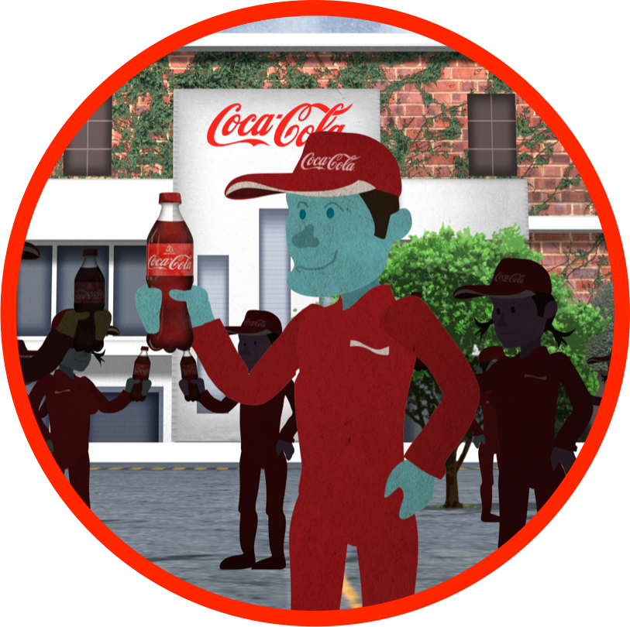



BUILDING LEADERS
CLIMATE AMBASSADORS
MODULE 1: INTRODUCTION
MODULE 2: BUSINESS CASE
MODULE 3:
IN ACTION
MODULE 4:
ENGAGEMENT
MODULE 5:
SCENARIO PLANNER
• WHY WE ARE HERE
• GOALS • TRAINING OBJ. • DISCUSSION
• BUSINESS STRATEGY
• REVENUE • RISK
• REPUTATION
ME, WE, WORLD
• STRATEGIC FRAME
• KEY INTERVENTIONS
• INGREDIENTS
• PACKAGING
• MANUFACTURING
• DISTRIBUTION
• REFRIGERATION
STEPS FOR ENGAGING SUPPLIERS
REVIEW SCENARIO PLANNER TOOL
PROVIDE FEEDBACK
Notes:
The Climate Ambassador training was developed to train experts in our system to help
Introduction: The 2020 Climate Target and the Role of Climate Ambassadors
STRATEGIC BACKGROUND
The Coca-Cola Company is expanding its carbon targets from manufacturing to encompass additional scope 3 elements across the broader supply/value chain, including upstream (ingredients and packaging) and downstream (distribution and refrigeration). The Company has adopted a new target to reduce the carbon footprint of the “drink in your hand” over this decade (2010-2020). This shift will require an additional set of capabilities to deliver on the new targets. For example, our employees will need to reach outside of their sphere of business control to partner with suppliers on emissions reductions projects –like reducing fertilizer use in our corn/sugar/citrus supply, reducing packaging, reducing fuel intensity in distribution, etc.
As part of building a new set of capabilities, the World Wildlife Fund partnered with The Coca-Cola Company to train a corps of Coca-Cola Climate Ambassadors as internal spokespeople and champions of climate innovation along the supply chain.

Slide 9




EXPANDED
END-TO-END FOCUS
INGREDIENTS
PACKAGING
MANUFACTURING
DISTRIBUTION
REFRIGERATION
Sweeteners
Fruit, Tea,
Coffee, CO₂
Primary
Secondary
Fuel
Electricity
Trucking
Fleet
Logistics
Refrigerants
Electricity
CO₂e
13%
38%
9%
8%
32%
“GROW THE BUSINESS NOT THE CARBON” 2015
Notes:
But this requires much focus across our entire value chain.

Slide 10
SHIFT IN GOAL FROM
ABSOLUTE to INTENSITY
INGREDIENTS
PACKAGING
MANUFACTURING
DISTRIBUTION
REFRIGERATION
Carbon Footprint “Drink in your hand”
2010:
412 g CO₂e/l
2020:
311 g CO₂e/l
101 g CO₂e/l
-25%
Absolute Emissions
2010:
59 million
metric tons
2020:
72 million
metric tons
+13 million
metric tons
+22%
Notes:
Historically, our targets have focused on Manufacturing. We have done solid progress and it now represents 9% of our Carbon Footprint (and only 1% of our water footprint) relative to other areas of our value chain. We now have a baseline (2010) for emissions from our entire Value Chain (end-to-end) – upon which we can set our broader 2020 targets.
In one sense this new target may be perceived as less ambitious that our current GBNC commitment – because it is a commitment on Intensity rather than Absolute reductions.
Example: Our GHG “intensity” (for Manufacturing) has improved 18% since 2004. But our “absolute” emissions have increased 11% -- due primarily to volume increase (35%).
60M tons = Colombia
13M = Jamaica, Burma
The Opportunity set and the Environmental Benefit of the new, broader scope is an order of magnitude higher:
The CURRENT commitment (2015) will prevent an estimated 2.6 million metric tons of CO₂e in 2015 – and 14.5 million cumulative 2004-2015.
The PROPOSED NextGen commitment (2020) will prevent an estimated 23.3 million metric tons of CO₂e in 2020 – and 115 million cumulative 2010-2020.

Slide 11
EXERCISE
Write down all the carbon reduction opportunities you see in the video.
Notes:
EXERCISE
Divide into two groups
Write down as many carbon reduction opportunities as you see in the video

Slide 12
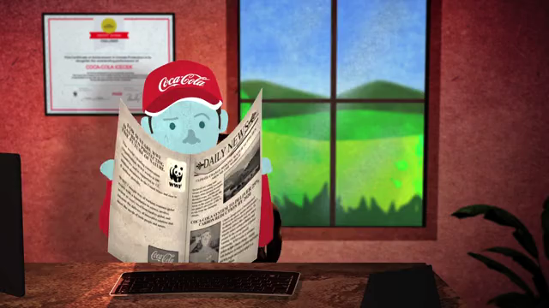
Notes:
VIDEO WILL BE EMBEDDED.
Right after the video, how many opportunities for emissions reductions can you remember from the video?

Slide 13
EASY
Drip irrigation
Fertilizer shift (soil management)
Wind farms and Photovoltaic
Plant Bottle packaging material reduction and bio-PET
Logistics and warehouse optimization
Fork lift fuel cell technology
Hybrid trucks
Energy management system refrigerators/HCFC free
NOT SO EASY
Top 10 campaign certificate
Energy savings signs
Building positioned to optimize sun and heat/cooling
Isolated management from production line/thermo climate adjustment
Computer screen saver/energy cycle
CFL/Florescent lighting systems
Window treatment (reflective film)
Diesel truck
Windmill for water pumping
Notes:
Scoring
Count the number you have. (Make sure they are truly different.)
Review the list we have.
What do you have that’s not on these lists.

Slide 14
CCESC
CLIMATE WORKSTREAM
TEAM MEMBERS
Jake Backus, Sustainability Director, Customer & Commercial Leadership
Tim Copeman, Group Environmental Manager, Coca-Cola Hellenic
Richard Crowther, Manager of Sustainable Energy, Coca-Cola Refreshments
Lucinda Hensman, Associate Director, CRS Communications, CCE
Alfredo Illescas, (former) Environmental Director, Coca-Cola Femsa
Bryan Jacob, Director of Climate Protection, Office of Sustainability
Ben R. Jordan, Director of Supplier Sustainability, GSP
Mario LaTorre, Environmental Director, Coca-Cola Andina
Carlos Pacheco, Energy Efficiency Manager, SES/CTO
Ulrike Sapiro, Corporate Responsibility and Sustainability Director, EUG
Mitsuru Shibata, SES Governance Manager, Japan BU
Klaus Stadler, Director of Environment & Water Resources, Europe Group
Rudi Sueys, Environment Manager – Energy, Europe Group
Kota Takasugi, PAC Environmental Performance Manager, Japan BU
Yukihiko Yoshimura, Environmental Director, Coca-Cola West (Japan)
Note: CCESC NextGen Climate Targets Team also sought input and support from the established Energy & Climate NETWORK.
Notes:
Before we launch into the day, we’d like to recognize the group of individuals across the system who have invested time and energy to help us develop our strategies and meet our goals. The team includes:
Jake Backus, Customer Sustainability Director, Customer and Commercial Leadership
Tim Copeman, Group Environmental Manager, Coca-Cola Hellenic
Richard Crowther, Manager of Sustainable Energy, Coca-Cola Refreshments
Lucinda Hensman, Associate Director, CRS Communications, Coca-Cola Enterprises
Alfredo Illescas, (former) Environmental Director, Coca-Cola Femsa
Bryan Jacob , Director of Climate Protection, Office of Sustainability
Ben R. Jordan, Director of Supplier Sustainability, Global Sustainable Procurement
Mario LaTorre, Environmental Director, Coca-Cola Andina
Carlos Pacheco, Energy Efficiency Manager, Safety and Environmental Sustainability
Ulrike Sapiro, Corporate Responsibility and Sustainability Director, Europe Group
Mitsuru Shibata, SES Governance Manager, Japan BU
Klaus Stadler, Director of Environment & Water Resources, Europe Group
Rudi Sueys, Environment Manager – Energy, Europe Group
Kota Takasugi, PAC Environmental Performance Manager, Japan BU
Yukihiko Yoshimura, Environmental Director, Coca-Cola West (Japan)

Slide 15
DISCUSSION
Notes:
Discussion.
(Instructors can lead their own discussions, or, if they prefer can use these sample questions:
What questions do you have about the goals we set?
The methods for getting there?
Who has ideas for how to leverage our bottlers to help set ambitious goals?
What questions do you have about the role of the Climate Ambassador?
What ideas do you have?
Is there anything missing?
Who would be great at this? (Think through marketing, sales, procurement departments)
How many of you feel like you could become an expert Climate Ambassador?

